Slide 1

Asian Foundations
Socialization and Parenting
in East Asia

Slide 2
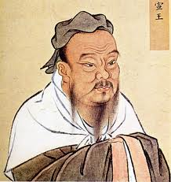
Confucius

Slide 3
Confucianism
1.11 The Master said:
When the father is alive, observe the son’s intent. When the father dies, observe the son’s conduct. One who does not alter his late father’s dao for three years may be called filial.

Slide 4
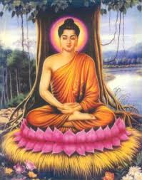
Buddhism

Slide 5
Buddhism
FILIAL PIETY IN THE BUDDHIST WAY
The Sutra teaches us that we have the kindness of our parents to be grateful for.
After becoming aware of the kindness of one’s own parents, one extends to all other parents and all other sentient beings the feelings of love and gratitude that this awareness generates.
Here, the awareness of the kindness of parent is treated as one facet of the awareness of the greater Buddha’s grace.

Slide 6
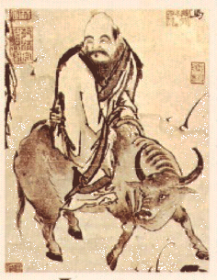
Daoism

Slide 7
Daoism
18
When the great Tao is forgotten,
goodness and piety appear.
When the body's intelligence declines,
cleverness and knowledge step forth.
When there is no peace in the family,
filial piety begins.
When the country falls into chaos,
patriotism is born.
S. Mitchell trans.

Slide 8
Socialization Goals
Self Development
Filial Piety
Collectivism

Slide 9
Parenting Styles
Authoritarian
Authoritative
Permissive
Guan/Training

Slide 10
Socialization Outcomes
Internalization of Social Goals
Children’s Perceptions
Adjustment Outcomes
Behavioral Outcomes

