Slide 1


World Literature 1
Putting it all together
ASDP Institute, Summer 2015
East-West Center, University of Hawai’i – Manoa
J.L. Keller – Professor of English
Middlesex Community College
Lowell, Massachusetts

Slide 2

What does an exemplary life look like?
What does each tradition contribute to the ongoing discussion?

Slide 3
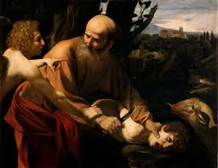
18th Century B.C.E.
Old Testament:
“The Binding of Isaac”
Obedience
Monotheistic faith

Slide 4
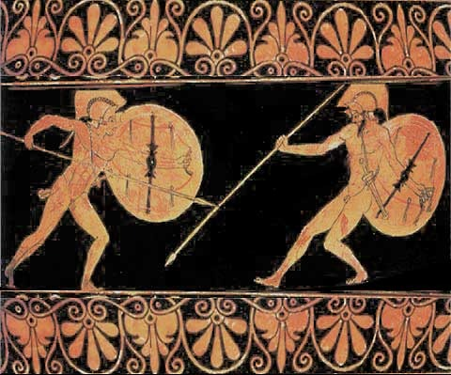
8th Century B.C.E.
Homer’s Iliad
Bravery
Successful warrior
Civic minded
Loyalty
Family
Personal honor, revenge
Personal achievement, wealth, possessions

Slide 5
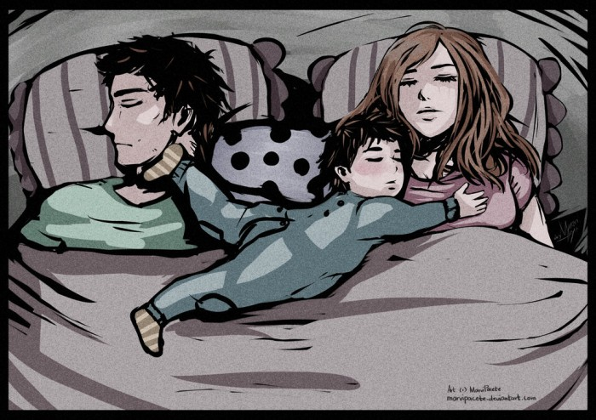
5th Century B.C.E.
Sophocles’ Oedipus
Humility
Respect for gods
Intellect
Stability vs change
Individual action
Submission to Fate
Service to the State

Slide 6
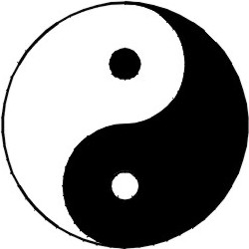
6th – 4th Century B.C.E.
Zhuangzi &
Laozi’s Daodejing
Life is transitory
Embrace change as constant
Qi
Inspiration from nature
Wu-wei (non-action)
Flow
Simple living, fasting of mind
We can all cultivate our lives and flourish
Repudiate wealth, achievement, strength vs ethical life

Slide 7
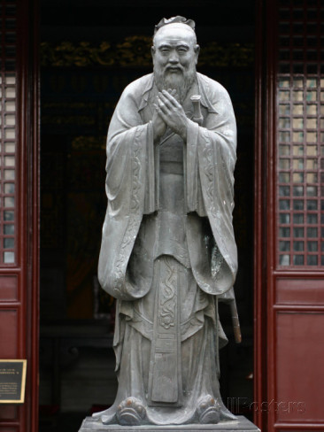
5^{th-} 3rd Century B.C.E.
Confucius’ Analects
Rituals
Gender roles
Filial duty
Respect elders
Harmony
Serve government
Honor for ancestors and family

Slide 8
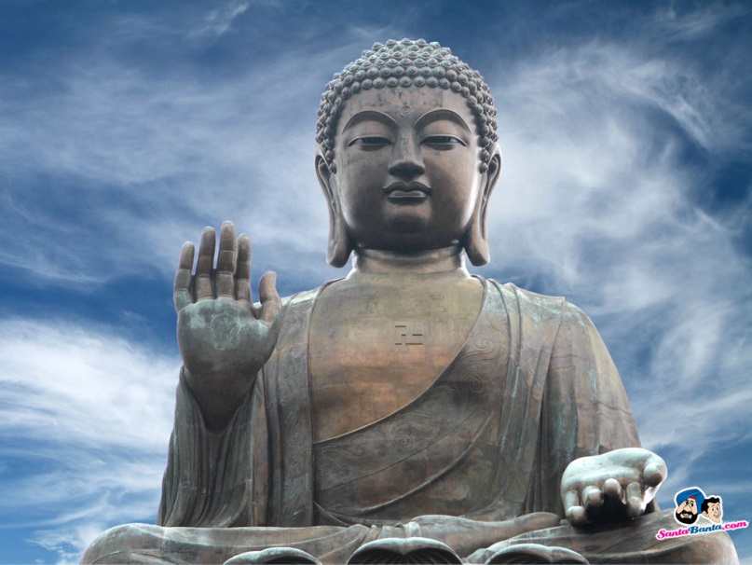
1st Century C.E.
Chinese Buddhism
Repudiate pursuit of wealth and personal achievements
Bodhisattvas
Follow the way
Individual journey to
enlightenment
We all have Buddha nature
Detach from possessions, desires

Slide 9
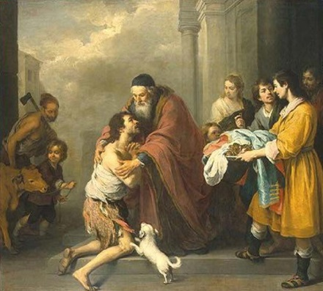
1st Century C.E.
New Testament:
Luke’s “Parable of the Prodigal Son”
Respect for elders, filial duty
Forgiveness
Religious faith
Humility
Family ties

Slide 10
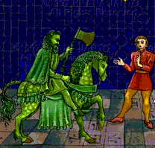
14th Century
Sir Gawain and the
Green Knight
Civility
Purity
Religious faith
Knightly virtues
Bravery
Physical strength

Slide 11
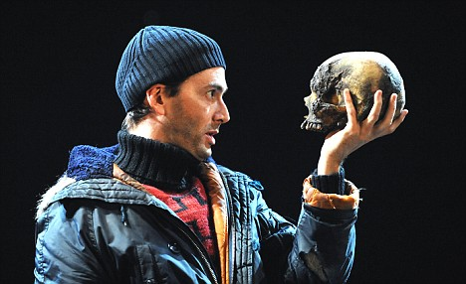
17th Century
Shakespeare’s Hamlet
Questioning of warrior and revenge values
Balance between deliberate thought and impulsive action
New personal ethics
"The readiness is all”
Being in the moment

Slide 12
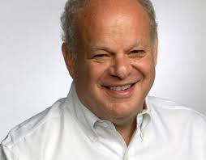
2000
Positive Psychology
Perseverance and grit (Duckworth)
Growth mindset (Dweck)
Everyone can flourish (Seligman)
Meditation (Fredrickson, Nhat Hanh, etc)
Connect with nature (Fredrickson)
Detach from pursuit of wealth
Flow (Csikszentmihalyi)
PERMA (positive emotions, engagement, relationships, meaning, accomplishment) (Seligman)

Slide 13

Additional Questions:
What are some comparisons and contrasts between various readings’ conceptions of an “exemplary life?”
What would today’s conception of an “exemplary life” look like?
What are some comparisons and
contrasts between these literary
works and today’s “exemplary life?”

Slide 14
Photos
Exemplary:
https://www.google.com/search?hl=en&site=imghp&tbm=isch&source=hp&biw=1350&bih=639&q=exemplary&oq=exemplary&gs_l=img.3..0l10.968.2665.0.3159.9.9.0.0.0.0.303.1057.0j3j1j1.5.0....0...1ac.1.64.img..4.5.1057.kWHsEW9Me5M#imgrc=RonF4JomAxQbWM%3A
Binding of Isaac: https://www.google.com/search?hl=en&site=imghp&tbm=isch&source=hp&biw=1350&bih=595&q=binding+of+isaac&oq=binding+of+isaac&gs_l=img.3..0l10.2219.4677.0.5125.16.9.0.3.3.0.325.1056.0j1j1j2.4.0....0...1ac.1.64.img..9.7.1066.OlJLJK-W-zg#hl=en&tbm=isch&q=binding+of+isaac+bible&imgrc=ugdyG4EaaaMhpM%3A
Iliad:
https://www.google.com/search?hl=en&site=imghp&tbm=isch&source=hp&biw=1350&bih=595&q=binding+of+isaac&oq=binding+of+isaac&gs_l=img.3..0l10.2219.4677.0.5125.16.9.0.3.3.0.325.1056.0j1j1j2.4.0....0...1ac.1.64.img..9.7.1066.OlJLJK-W-zg#hl=en&tbm=isch&q=iliad&imgrc=Rq6R-SHy7r0ZGM%3A
Oedipus
https://www.google.com/search?hl=en&site=imghp&tbm=isch&source=hp&biw=1350&bih=595&q=binding+of+isaac&oq=binding+of+isaac&gs_l=img.3..0l10.2219.4677.0.5125.16.9.0.3.3.0.325.1056.0j1j1j2.4.0....0...1ac.1.64.img..9.7.1066.OlJLJK-W-zg#hl=en&tbm=isch&q=oedipus+complex&imgrc=PgQdkH_n9cCosM%3A
Confucius
https://www.google.com/search?hl=en&site=imghp&tbm=isch&source=hp&biw=1350&bih=595&q=binding+of+isaac&oq=binding+of+isaac&gs_l=img.3..0l10.2219.4677.0.5125.16.9.0.3.3.0.325.1056.0j1j1j2.4.0....0...1ac.1.64.img..9.7.1066.OlJLJK-W-zg#hl=en&tbm=isch&q=confucius&imgrc=V8gcxr22NQ_CtM%3A
Daoism
https://www.google.com/search?hl=en&site=imghp&tbm=isch&source=hp&biw=1350&bih=595&q=binding+of+isaac&oq=binding+of+isaac&gs_l=img.3..0l10.2219.4677.0.5125.16.9.0.3.3.0.325.1056.0j1j1j2.4.0....0...1ac.1.64.img..9.7.1066.OlJLJK-W-zg#hl=en&tbm=isch&q=daoism&imgrc=bqx2X5nVg6ADhM%3A
Buddhism
https://www.google.com/search?hl=en&site=imghp&tbm=isch&source=hp&biw=1350&bih=595&q=binding+of+isaac&oq=binding+of+isaac&gs_l=img.3..0l10.2219.4677.0.5125.16.9.0.3.3.0.325.1056.0j1j1j2.4.0....0...1ac.1.64.img..9.7.1066.OlJLJK-W-zg#hl=en&tbm=isch&q=buddha&imgrc=zMpyj-OJLtdyGM%3A

Slide 15
Photos, Cont’d
Prodigal Son
https://www.google.com/search?hl=en&site=imghp&tbm=isch&source=hp&biw=1280&bih=907&q=parable+of+the+prodigal+son&oq=parable+of+the+prodigal+son&gs_l=img.3..0l4j0i30j0i5i30l5.1639.6580.0.7164.27.19.0.8.8.0.160.2117.0j19.19.0....0...1ac.1.64.img..0.27.2175.lssrIBc0cj4#imgrc=B6WmZePL0ESTTM%3A
Gawain
https://www.google.com/search?hl=en&site=imghp&tbm=isch&source=hp&biw=1350&bih=595&q=binding+of+isaac&oq=binding+of+isaac&gs_l=img.3..0l10.2219.4677.0.5125.16.9.0.3.3.0.325.1056.0j1j1j2.4.0....0...1ac.1.64.img..9.7.1066.OlJLJK-W-zg#hl=en&tbm=isch&q=sir+gawain+and+the+green+knight&imgrc=1mwSsJ4woQ_64M%3A
Hamlet:
https://www.google.com/search?hl=en&site=imghp&tbm=isch&source=hp&biw=1350&bih=595&q=binding+of+isaac&oq=binding+of+isaac&gs_l=img.3..0l10.2219.4677.0.5125.16.9.0.3.3.0.325.1056.0j1j1j2.4.0....0...1ac.1.64.img..9.7.1066.OlJLJK-W-zg#hl=en&tbm=isch&q=hamlet+skull&imgrc=fxDafZauaoVYRM%3A
Positive Psychology – M. Seligman
https://www.google.com/search?hl=en&site=imghp&tbm=isch&source=hp&biw=1350&bih=595&q=binding+of+isaac&oq=binding+of+isaac&gs_l=img.3..0l10.2219.4677.0.5125.16.9.0.3.3.0.325.1056.0j1j1j2.4.0....0...1ac.1.64.img..9.7.1066.OlJLJK-W-zg#hl=en&tbm=isch&q=positive+psychology+martin+seligman&imgrc=HMh8ZTQV_amoEM%3A
Questions
https://www.google.com/search?hl=en&site=imghp&tbm=isch&source=hp&biw=1350&bih=595&q=binding+of+isaac&oq=binding+of+isaac&gs_l=img.3..0l10.2219.4677.0.5125.16.9.0.3.3.0.325.1056.0j1j1j2.4.0....0...1ac.1.64.img..9.7.1066.OlJLJK-W-zg#hl=en&tbm=isch&q=questions&imgrc=kqWShYp3qCsjfM%3A

